Slide 1
Distributed Object-Based Systems

Slide 2
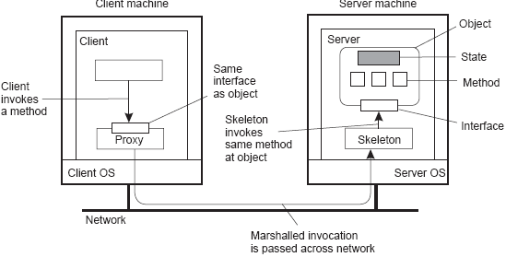
Remote distributed objects
Data and operations encapsulated in an object
Operations implemented as methods grouped into interfaces
Object offers only its interface to clients
Object server is responsible for a collection of objects
Client stub (proxy) implements interface
Server skeleton handles (un)marshaling and object invocation

Slide 3
Remote distributed objects
Types of objects I
Compile-time objects: Language-level objects, from which proxy and skeletons are automatically generated.
Runtime objects: Can be implemented in any language, but require use of an object adapter that makes the implementation appear as an object.
Types of objects II
Transient objects: live only by virtue of a server: if the server exits, so will the object.
Persistent objects: live independently from a server: if a server exits, the object’s state and code remain (passively) on disk.

Slide 4
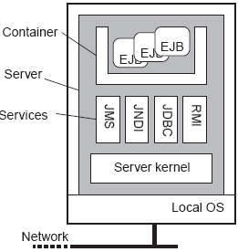
Example: Enterprise Java Beans (EJB)
What is it
Java object hosted by special server that allows for different means of calling the object by remote clients.

Slide 5
Types of EJBs
Four different types
Stateless session bean: Transient object, called once, does its work and is done. Example: execute an SQL query and return result to caller.
Stateful session bean: Transient object, but maintains client-related state until the end of a session. Example: shopping cart.
Entity bean: Persistent, stateful object, can be invoked during different sessions. Example: object maintaining client info on last number of sessions.
Message-driven bean: Reactive objects, often triggered by message types. Used to implement publish/subscribe forms of communication.

Slide 6
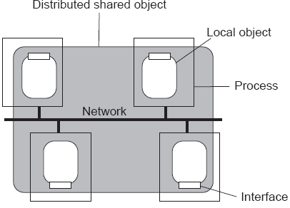
Globe distributed objects
Observation
Most distributed objects are not distributed at all: state is kept at a single node. Alternative: Globe objects, which are physically distributed across multiple machines.

Slide 7
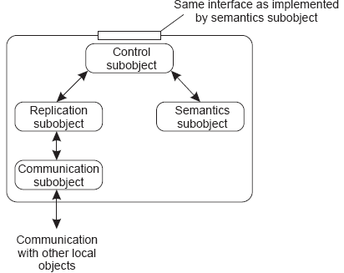
Globe distributed objects
Note
To make DSOs generic, we need to separate function from distribution support

Slide 8
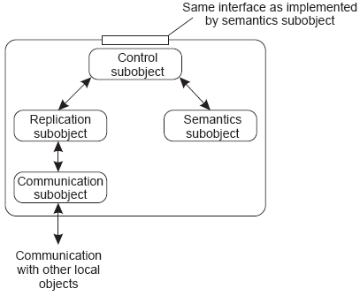
Globe distributed objects
Note
Replication subobject essentially decides how and when the local semantics subobject will be invoked.

Slide 9
Processes: Object servers
Servant
The actual implementation of an object, sometimes containing only method implementations:
Collection of C or COBOL functions, that act on structs, records, database tables, etc.
Java or C++ classes
Skeleton
Server-side stub for handling network I/O:
Unmarshalls incoming requests, and calls the appropriate servant code
Marshalls results and sends reply message
Generated from interface specifications

Slide 10
Processes: Object servers
Object adapter
The “manager” of a set of objects:
Inspects (as first) incoming requests
Ensures referenced object is activated (requires identification of servant)
Passes request to appropriate skeleton, following specific activation policy
Responsible for generating object references

Slide 11
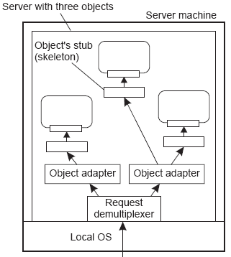
Processes: Object servers
Observation
Object servers determine how their objects are constructed

Slide 12
Example: Ice
main(int argc, char* argv[]) {
Ice::Communicator ic;
Ice::ObjectAdapter adapter;
Ice::Object object;
ic = Ice::initialize(argc, argv);
adapter = ic->createObjectAdapterWithEndPoints( "MyAdapter","tcp -p 10000");
object = new MyObject;
adapter->add(object, objectID);
adapter->activate();
ic->waitForShutdown();
}
Note
Activation policies can be changed by modifying the properties attribute of an adapter. Ice aims at simplicity, and achieves this partly by putting policies into the middleware.

Slide 13
Client-to-object binding
Object reference
Having an object reference allows a client to bind to an object:
Reference denotes server, object, and communication protocol
Client loads associated stub code
Stub is instantiated and initialized for specific object
Two ways of binding
Implicit: Invoke methods directly on the referenced object
Explicit: Client must first explicitly bind to object before invoking it

Slide 14
Client-to-object binding: implicit/explicit
Distr object* obj ref; Distr object* obj ref;
obj ref = ...; Local object* obj ptr;
obj ref->do something(); obj ref = ...;
obj ptr = bind(obj ref);
obj ptr->do something();
Some remarks
Reference may contain a URL pointing to an implementation file
(Server,object) pair is enough to locate target object
We need only a standard protocol for loading and instantiating code
Observation
Remote-object references allow us to pass references as parameters. This was difficult with ordinary RPCs.

Slide 15
Remote Method Invocation (RMI)
Basics
(Assume client stub and server skeleton are in place)
Client invokes method at stub
Stub marshals request and sends it to server
Server ensures referenced object is active:
  Create separate process to hold object
  Load the object into server process
  ...
Request is unmarshaled by object’s skeleton, and referenced method is invoked
If request contained an object reference, invocation is applied recursively (i.e., server acts as client)
Result is marshaled and passed back to client
Client stub unmarshals reply and passes result to client application

Slide 16
RMI: Parameter passing
Object reference
Much easier than in the case of RPC:
Server can simply bind to referenced object, and invoke methods
Unbind when referenced object is no longer needed

Slide 17
RMI: Parameter passing
Object-by-value
A client may also pass a complete object as parameter value:
An object has to be marshaled:
  Marshall its state
  Marshall its methods, or give a reference to where an implementation can be found
Server unmarshals object. Note that we have now created a copy of the original object.
Object-by-value passing tends to introduce nasty problems

Slide 18
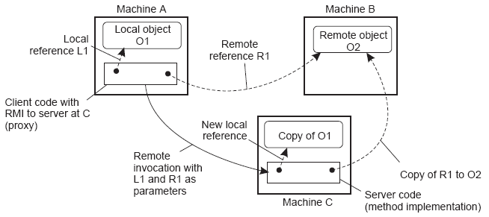
RMI: Parameter passing
Note
Systemwide object reference generally contains server address, port to which adapter listens, and local object ID. Extra: Information on protocol between client and server (TCP, UDP, SOAP, etc.)

Slide 19
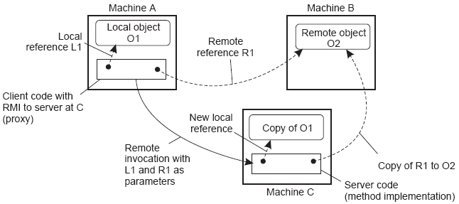
RMI: Parameter passing
Question
What’s an alternative implementation for a remote-object reference?

Slide 20
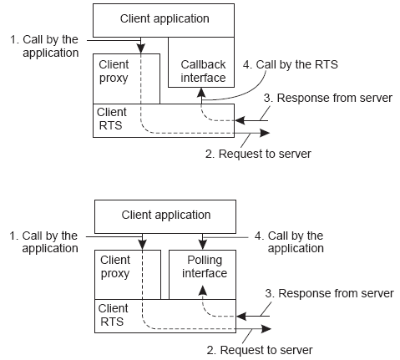
Object-based messaging

Slide 21
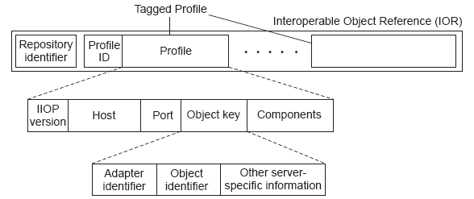
Object references
Observation
In order to invoke remote objects, we need a means to uniquely refer to them. Example: CORBA object references.

Slide 22
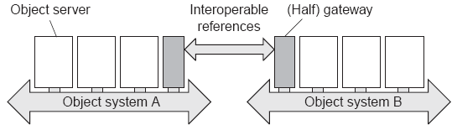
Object references
Observation
It is not important how object references are implemented per object-based system, as long as there is a standard to exchange them between systems.
Solution
Object references passed from one RTS to another are transformed by the bridge through which they pass (different transformation schemes can be implemented)

Slide 23
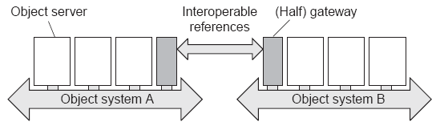
Object references
Observation
Passing an object reference refA from RTS A to RTS B circumventing the A-to-B bridge may be useless if RTS B doesn’t understand refA

Slide 24
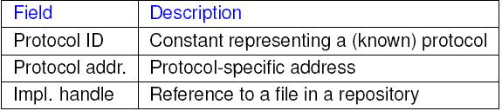

Globe object references: location independent
Stacked address
Stack of addresses representing the protocol to speak:
Instance address
Contains all that is needed to talk in a propritary way to an object:

Slide 25
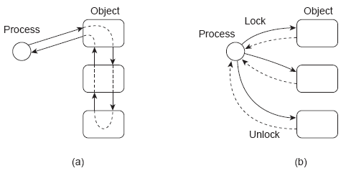
Synchronization
Issue
Client stubs hide many of the interactions with objects, which may not always be a good idea

Slide 26
Synchronization
Other problem
Should we have server-side or client-side synchronization:
Server: Problems when client crashes
Clients: Problems when clients at different machines need to synchronize
Java
Clients at same machine are automatically synchronized; those from different machines are not.

Slide 27
Consistency and replication
Observation
Objects form a natural means for realizing entry consistency:
Data are grouped into units, and protected by a synchronization variable (i.e., lock)
Synchronization variables adhere to sequential consistency (i.e., values are set atomically)
Operations of grouped data can be nicely grouped: object
Problem
What happens when objects are replicated? One way or the other we need to ensure that operations on replicated objects are properly ordered.

Slide 28
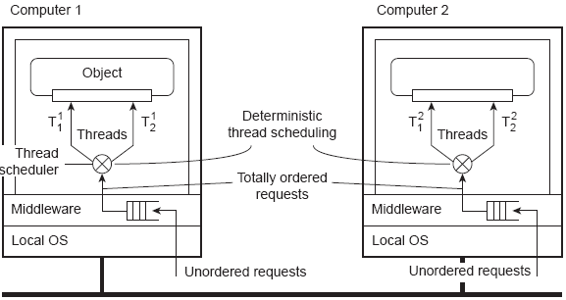
Replicated objects
Problem
We need to make sure that requests are ordered correctly at the servers and that threads are deterministically sheduled

Slide 29
Replicated objects
Observation
We are dealing with nasty issues here. Simplicity may dictate completely serialized (i.e., single-threaded) executions at the server.

Slide 30
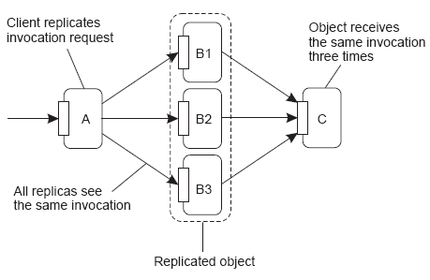
Replicated invocations
Active replication
Updates are forwarded to multiple replicas, where they are carried out. There are some problems to deal with in the face of replicated invocations

Slide 31
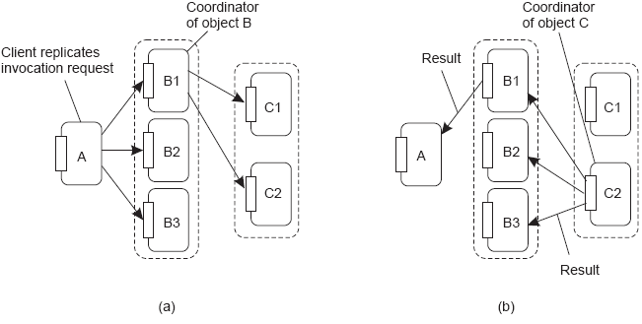
Replicated invocations
Solution
Assign a coordinator on each side (client and server), which ensuresthat only one invocation, and one reply is sent

Slide 32
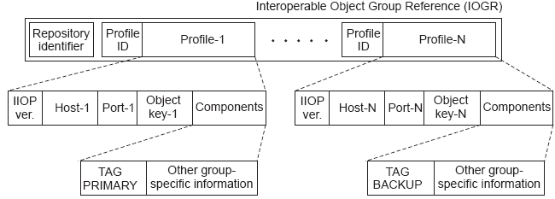
Fault tolerance
Observation
Nothing really new to report – object systems handle fault tolerance as you would expect them to do.
Example
CORBA uses special interoperable object group references to allow a client to access replicas:

Slide 33
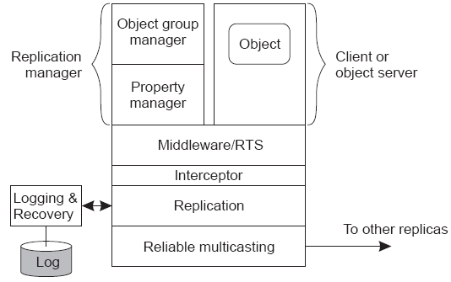
CORBA FT: Architecture

Slide 34
Security
When objects can (also) be moved/copied around
We need to consisder three different security aspects:
Secure binding: is client $ object binding authorized?
Secure invocation: is client authorized to invoke a method?
Platform security: is object protected against underlying platform and vice versa?
Example
For Globe we have the following public/private key pairs:
Object key: Owner of the private key can set access rights for users and replica servers.
Replica key: Used to make sure that a replica server is hosting an object.
User key: Associated with every user.

Slide 35
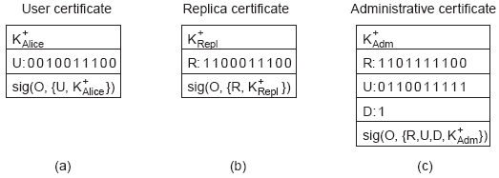
Globe security
User certificate: U[i] = 1 iff user is allowed to invoke method Mi .
Replica certificate: R[i] = 1 iff replica is allowed to execute Mi .
Administrative certificate: U[i] = 1 iff a user certificate for Mi may be issued. Same for R[i].

Slide 36
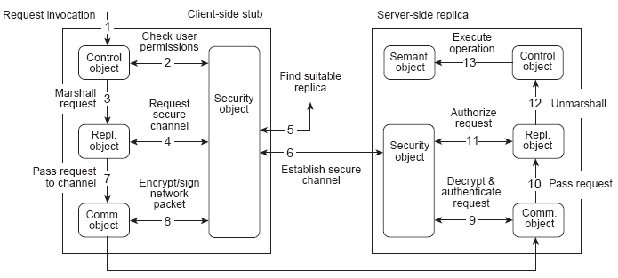
Secure method invocation
Application issues an invocation request.
Control subobject checks user permissions; security object should have valid user certificate.
Request is marshaled and passed on.

Slide 37
Secure method invocation
Replication subobject requests middleware to set up secure channel to suitable replica.
Security object initiates a replica lookup.
Security subobject sets up secure channel. The replica must prove it is allowed to carry out the requested invocation.

Slide 38
Secure method invocation
Request is passed on to comm. subobject.
Comm. subobject encrypts and signs the request.
Request is decrypted and authenticated.
Request is passed to server-side repl. subobject.

Slide 39
Secure method invocation
Authorization takes place; user certificate from client-side stub ia passed to replica to verify that request can be carried out.
Request is unmarshaled.
Operation can be executed.

